Slide 1
COMP7409C Machine Learning in Trading and Finance
This course offers an overview of Machine Learning to students and prepares them with essential skills to apply it in problem-solving for Trading and Finance.

Slide 2
About this course
Instructor
H.F. TING
TAs:
Jolly CHENG
Karen CHOW

Slide 3
About this course
Assessment
Three programming assignments (65%):
A1: 20%
A2: 20%
A3: 25%
Final Exam (35%)

Slide 4
Topics to be covered
Basics of Data Science
Basics of Machine Learning
Financial fault detection using ML
Financial forecasting using ML
NLP and Sentiment Analysis
Trading bot with reinforcement learning
Recommendation system
Option pricing with deep learning

Slide 5
Assignment release schedule
L1 11/6 L2 14/6 L3 18/6 L4 25/6 release A1 L5 28/6 L6 2/7 L7 9/7 release A2 L8 12/7 L9 16/7 L10 23/7 release A3

Slide 6
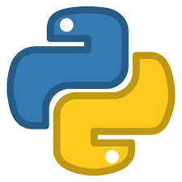
Programming Languages: Python
Why Python?
Free & open source
Simple syntax, easy to self-learn and understand
General-purpose programming language
Has a rich set of libraries and packages designed for data science and machine learning
Good memory management and high performance
Notes:
Python is clear and intuitive – Coding and debugging is easy, it’s the best choice for beginners;
Python General-purpose (not limited to working with data only): simple applications, integrate with web apps/databases, data science (data collection, data preprocessing, data analysis, data visualization), machine learning (e.g. data prediction)
R is a very unique language and has some really interesting features which aren’t present in other languages.
Libraries, e.g. df.describe() gives mean, min, max, std, median, etc.
https://www.analyticsinsight.net/top-10-data-science-programming-languages-for-2020/
https://medium.com/datadriveninvestor/top-6-data-science-programming-languages-for-2019-39ba1b6819a8
https://jelvix.com/blog/top-data-science-programming-languages
https://www.datacamp.com/community/tutorials/r-or-python-for-data-analysis
https://www.whizlabs.com/blog/python-or-r-which-should-learn/

Slide 7
Programming Languages for this course:
Python
Why Python?
Free & open source
Simple syntax, easy to self-learn and understand
General-purpose programming language
Has a rich set of libraries and packages designed for data science and machine learning
Good memory management and high performance
But,
I don't know where to find these packages
and even if I know where to download the
package I need,
I don't know how to install it; different
packages would have different installation
procedures.
Notes:
Python is clear and intuitive – Coding and debugging is easy, it’s the best choice for beginners;
Python General-purpose (not limited to working with data only): simple applications, integrate with web apps/databases, data science (data collection, data preprocessing, data analysis, data visualization), machine learning (e.g. data prediction)
R is a very unique language and has some really interesting features which aren’t present in other languages.
Libraries, e.g. df.describe() gives mean, min, max, std, median, etc.
https://www.analyticsinsight.net/top-10-data-science-programming-languages-for-2020/
https://medium.com/datadriveninvestor/top-6-data-science-programming-languages-for-2019-39ba1b6819a8
https://jelvix.com/blog/top-data-science-programming-languages
https://www.datacamp.com/community/tutorials/r-or-python-for-data-analysis
https://www.whizlabs.com/blog/python-or-r-which-should-learn/

Slide 8
Anaconda Repository (Anaconda Repo)
Anaconda repo is an open-source distribution of Python programs for scientific computing, data science, and machine learning.
It is a cloud-based platform where users can find and share packages and programs.
It includes thousands of packages for data science, machine learning, and scientific computing.
It makes it easy for users to find and install the packages they need for their data analysis and modelling tasks.

Slide 9
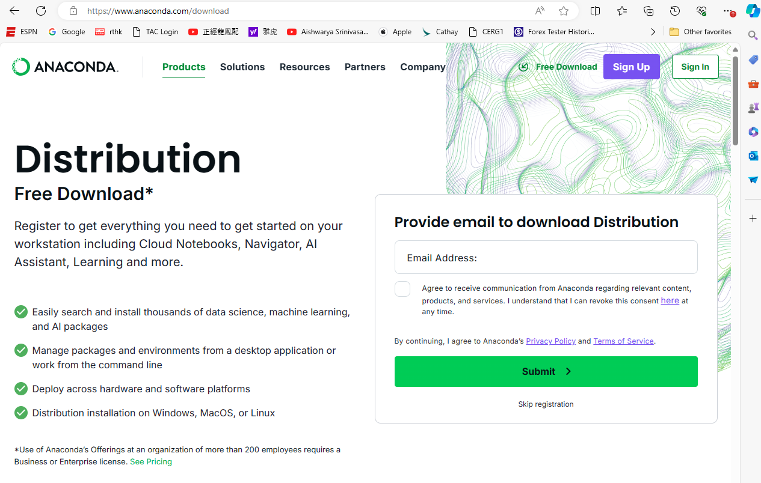
How to install Anaconda?
Simply download and install Anaconda Distribution via
https://www.anaconda.com/download

Slide 10
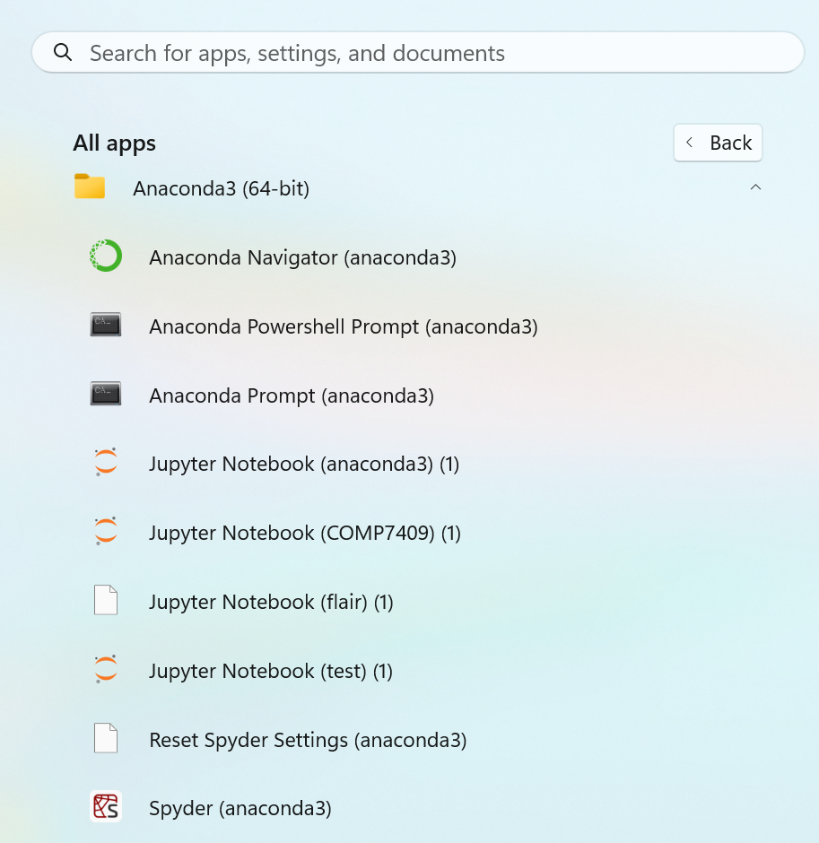
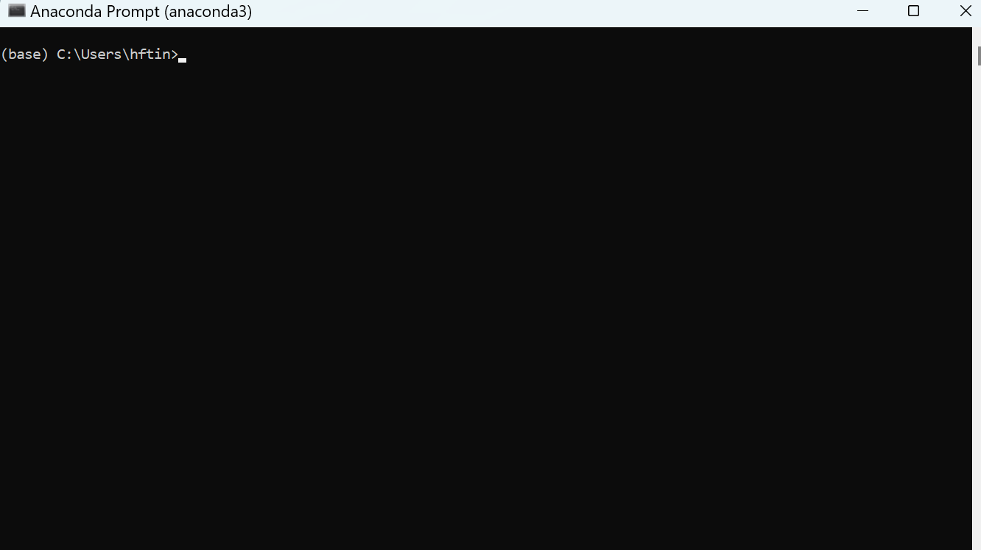
After installing Anaconda (on my Window 11 Home)

Slide 11
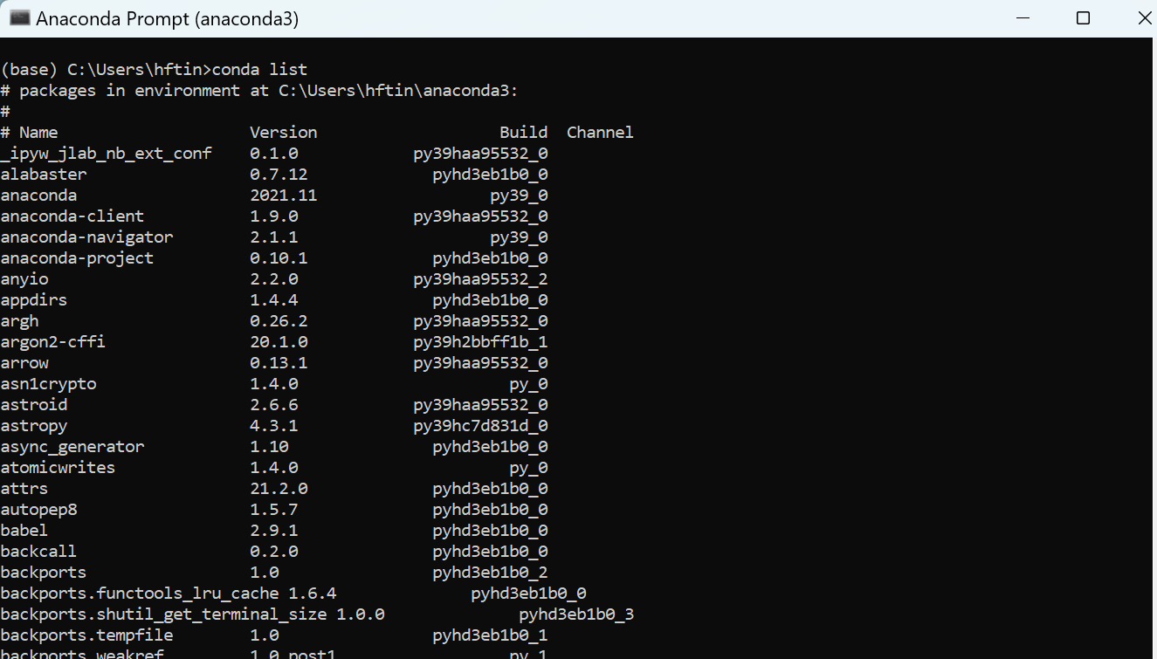
After installing Anaconda (on my Window 11 Home)

Slide 12
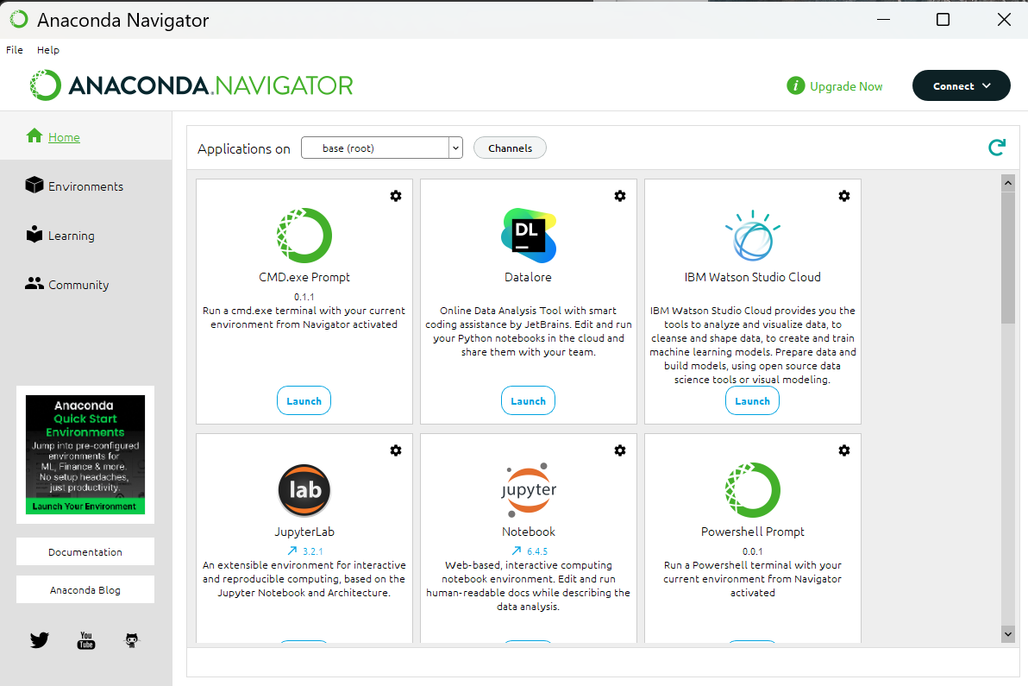
There are many other useful tools from Anaconda

Slide 13
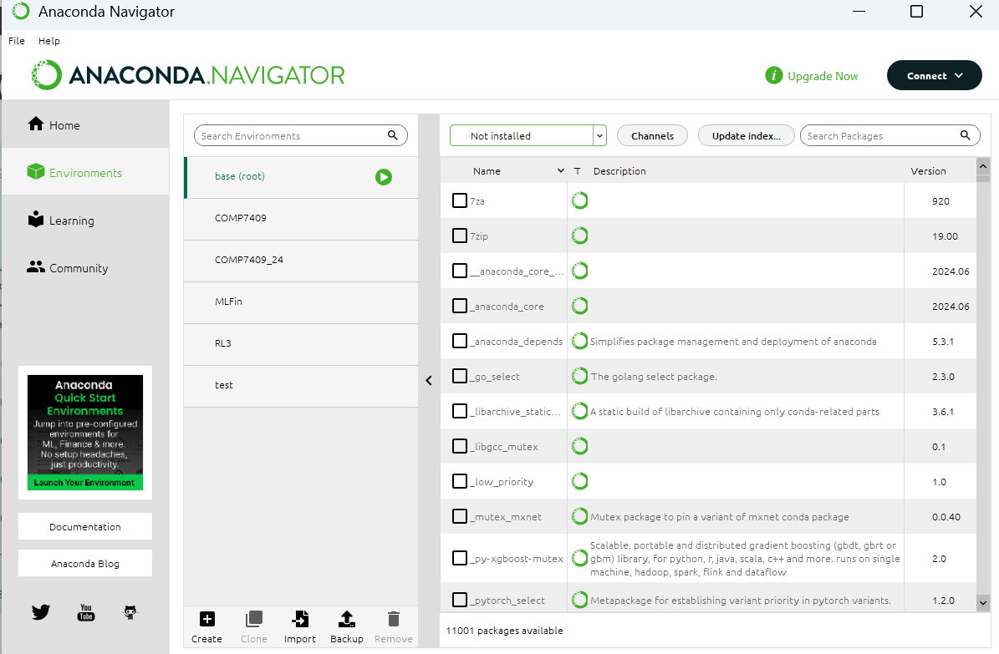
There are many other useful tools from Anaconda

Slide 14
The Python Package Index (PyPI)
In some of our examples we will use the pip command to install directly package from PyPI in our program. (You will know why in a minute)
The Python Package Index is a respository of software packages maintain by the Python Software Foundation.
pip is the package managers for PyPI (more info later).

Slide 15

IPython and Jupyter Notebook
IPython, also known as Interactive Python, is a powerful tool that allows you to write Python program interactively; i.e., you can type a fragment of the program, then run it to see the results, make the necessary changes, and once satisfied, continue to input the following statements.

Slide 16
We will use iPython and Jupyter Notebook to write our Python programs.

Slide 17
IPython and Jupyter Notebook
IPython, also known as Interactive Python, is a powerful tool that allows you to write Python program interactively; i.e., you can type a fragment of the program, then run it to see the results, make necessary changes, and once satisfied, continue to input more statements.

Slide 18
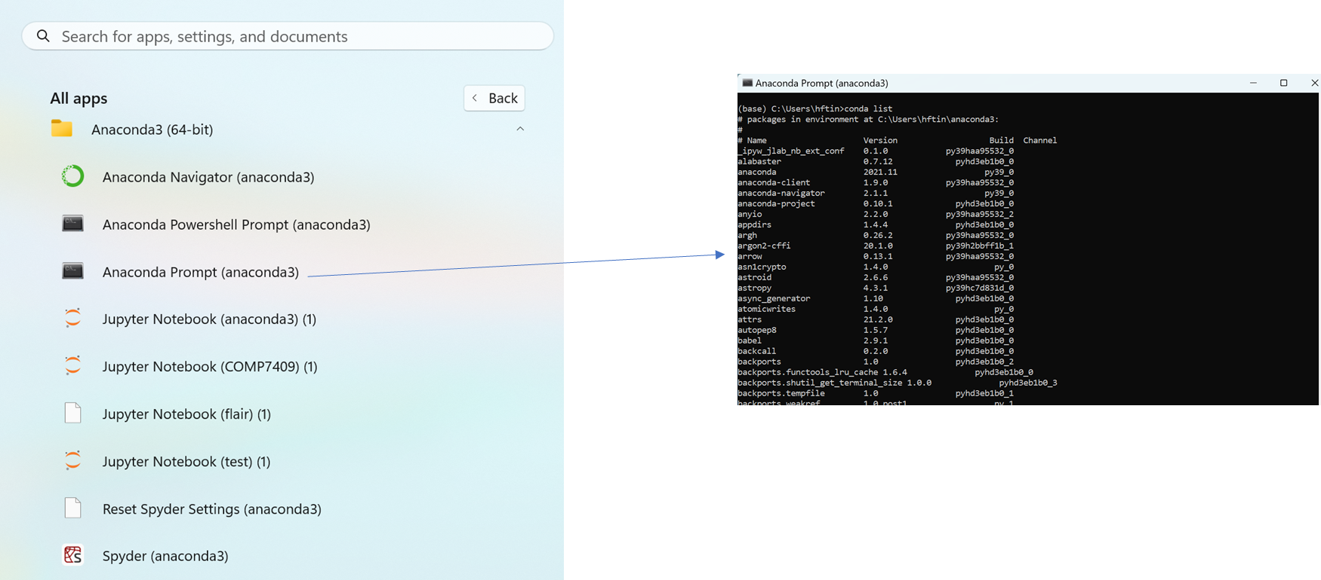
IPython and Jupyter Notebook
IPython, also known as Interactive Python, is a powerful tool that allows you to write Python program interactively; i.e., you can type a fragment of the program, then run it to see the results, make the necessary changes, and once satisfied, continue to input the following statements.

Slide 19
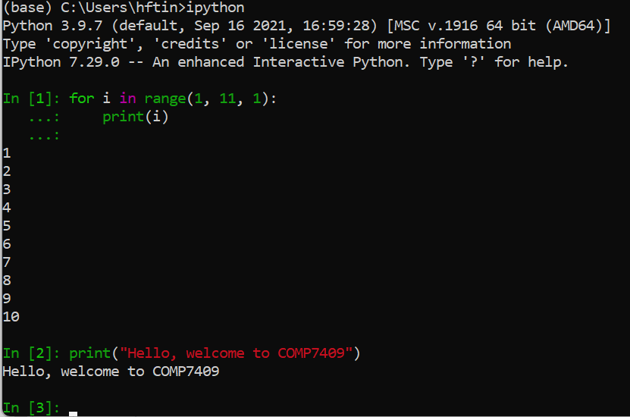
IPython and Jupyter Notebook
IPython, also known as Interactive Python, is a powerful tool that allows you to write Python program interactively; i.e., you can type a fragment of the program, then run it to see the results, make the necessary changes, and once satisfied, continue to input the following statements.

Slide 20
IPython and Jupyter Notebook
Jupyter Notebook is a browser-based tool that is the IDE (Integrated Development Environment) for IPython. Beside the standard output, it also support graphs, audio and video output. It contains an ordered list of input/output cells. You write a fragment of your program in an input cell, run it and the result will be displayed in the output cell.

Slide 21
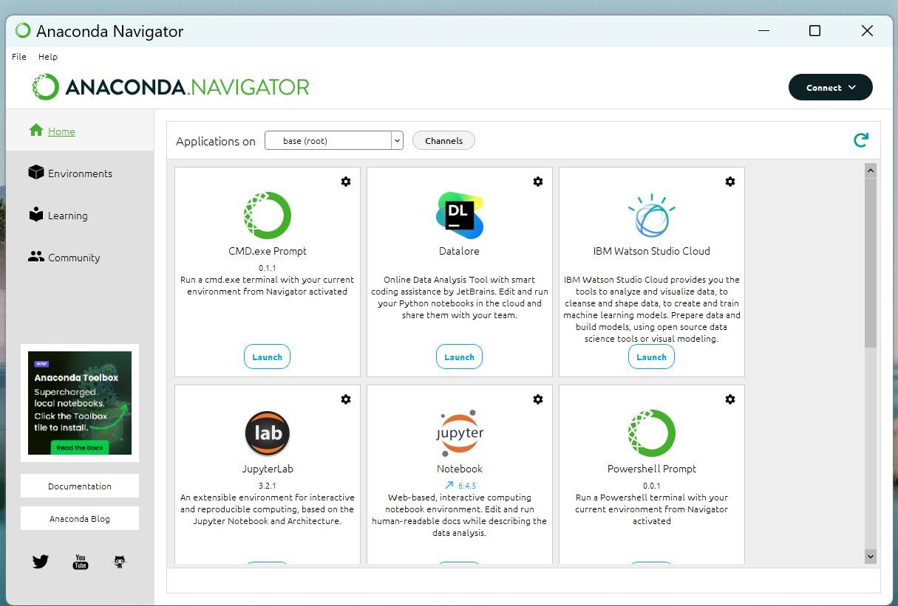
Another way for opening Jupyter Notebook

Slide 22
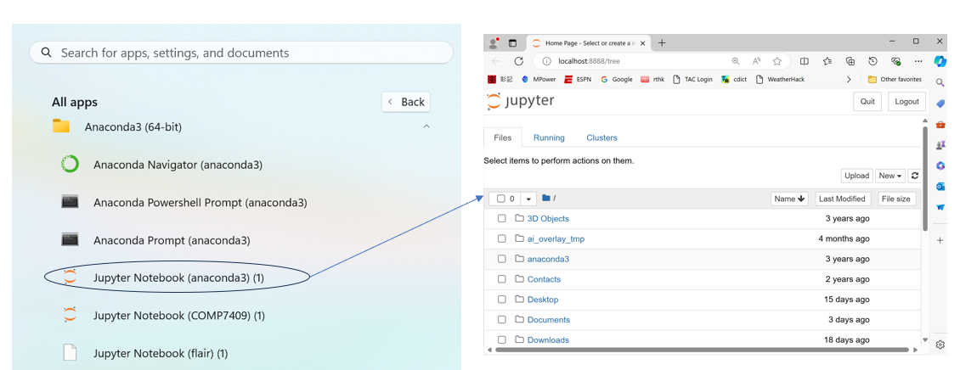
IPython and Jupyter Notebook
Another way to invoke Jupyter NB

Slide 23
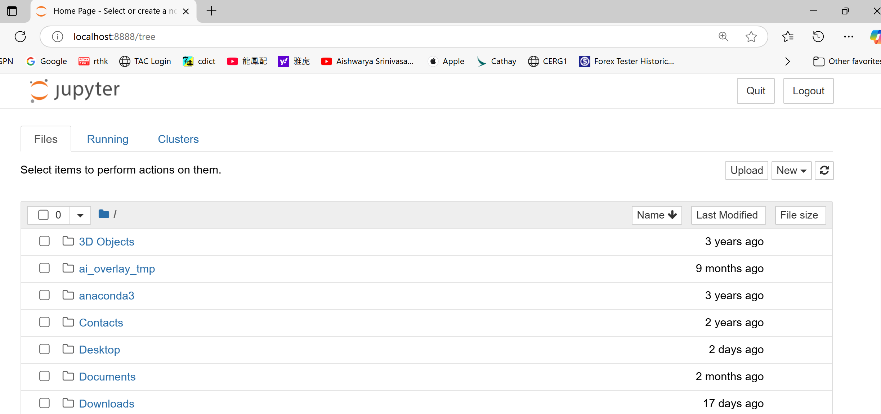
The browser-based interface of Jupyter NB

Slide 24
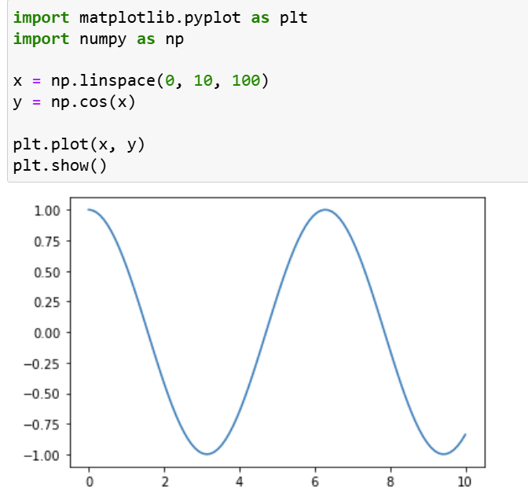
An example
An example: JupyterOutput.ipynb
Note: A Jupyter notebook has extension .ipynb,
not .py. You cannot run Jupyter notebook on a
Python IDE, say IDLE. But Jupyter allows you to
convert a .ipynb file to a .py file.

Slide 25
An example
An example: JupyterOutput.ipynb
code
cell
output
cell

Slide 26
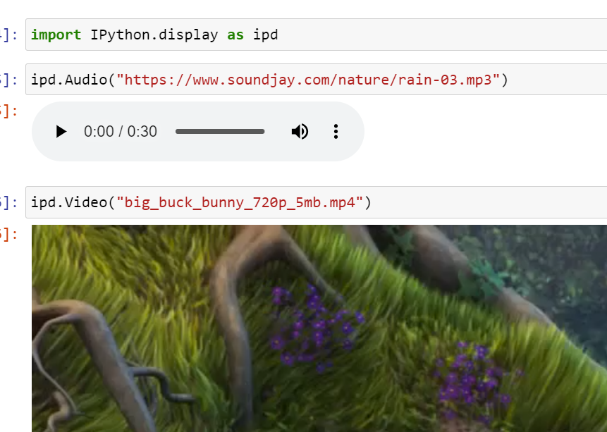

Slide 27
Colab: Running Jupyter NB on internet
Jupyter notebook is a browser-based tool
You open and execute it using any web browser.
What we have done:
We write our NB in our local computer: you open a web browser (e.g., Microsoft Edge) locally to run the notebook.
But, we can also write and execute our NB on some remote servers on internet.

Slide 28
Colab: Running Jupyter NB on internet
In the last few years, Google’s Colaboratory (Colab) becomes one of the most popular cloud platform for data scientists to develop data science applications and perform data analytics.
Colab supports a convenient environment that allows us to store our Jupyter notebooks on Google Drive and execute them using Google’s cloud server.
You don’t need to worry about the installation of most packages as you run your programs in its cloud, though for some special ones, you still need to install it using pip, which is a package installer for installing packets in the repository Python Package Index (PyPI).

Slide 29


How to use Colab?
1. Sign in your Google account

Slide 30

2. Open google drive

Slide 31
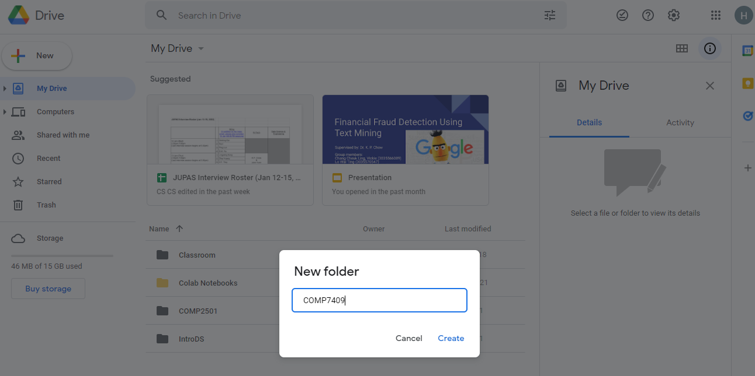
3. Create a folder

Slide 32
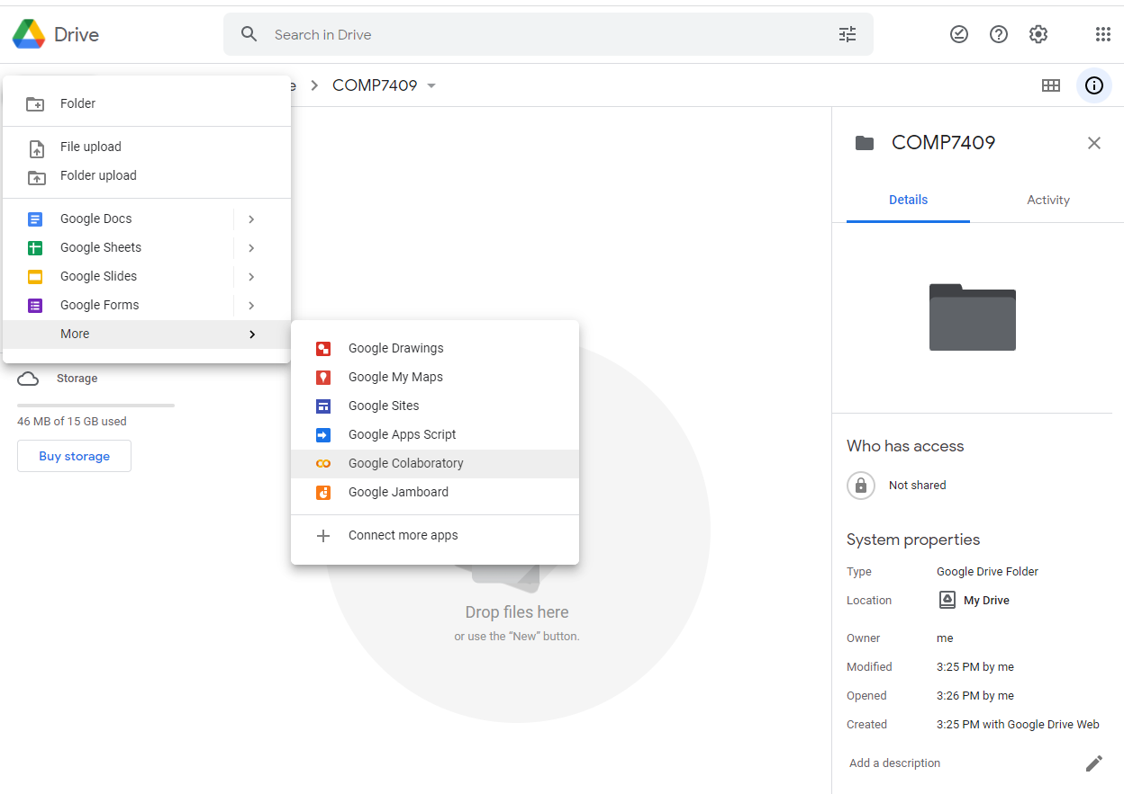
4. Move to that folder, and create a new “Colab” page

Slide 33
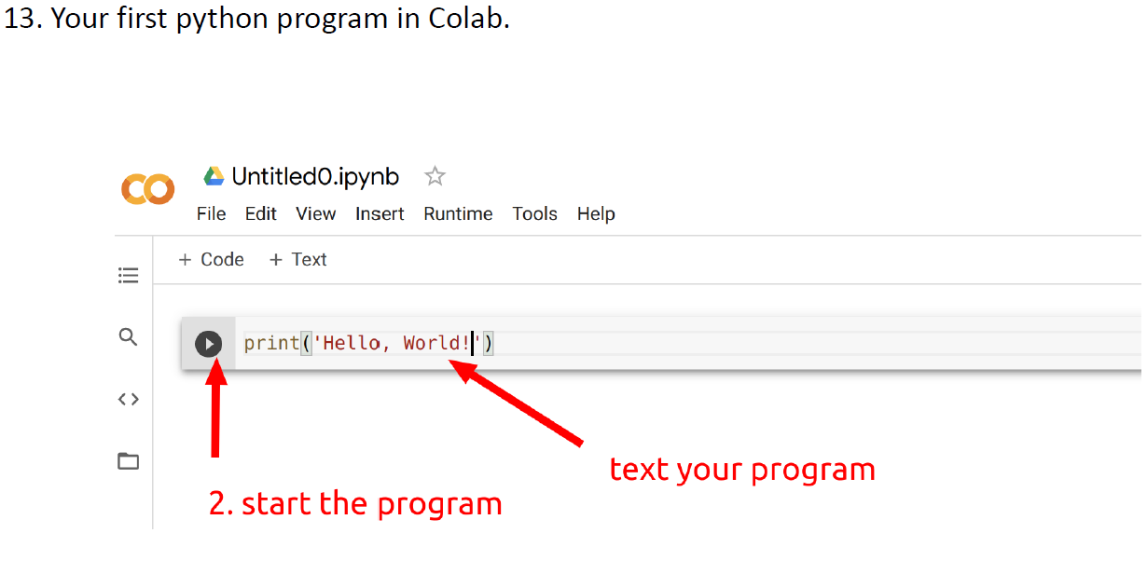
4. You can input your program now

Slide 34
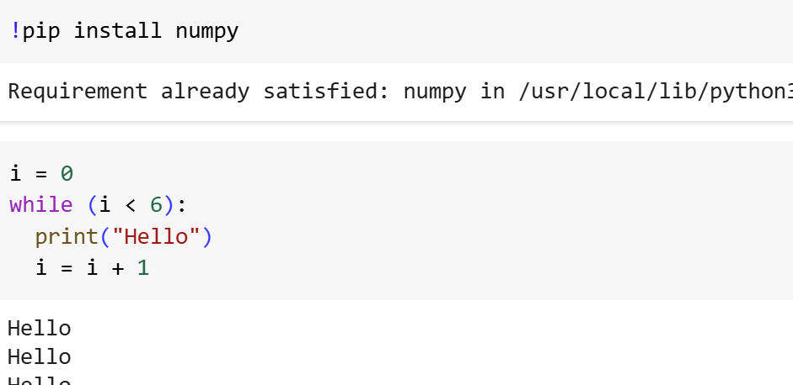
How to install package when using colab
Like Anaconda, colab has pre-installed many popular libraries and packages like
numpy, panda and matplotlib. For other packages, you can use the command
pip to install those packages from Python Package Index.
For example,

Slide 35
What’s next?
We will now cover some basic background:
Advanced Python
Numpy
Pandas
Machine Learning basics
Important: You need to know how to program in Python. This course will not teach Python basics.

Slide 36
Advanced Python: Classes and Objects
Python is an object-oriented programming language.
The machine language packages available in popular libraries such as Scikit-learn and Tensorflow are all implemented using classes and objects.

Slide 37
Classes and Objects in Python
Classes are the blueprint/recipe for object creation.
Basically, classes are composed of two things:
Attributes: They are “variables” used to store date
Methods: They are functions defined within class.
Objects are instances of classes.

Slide 38
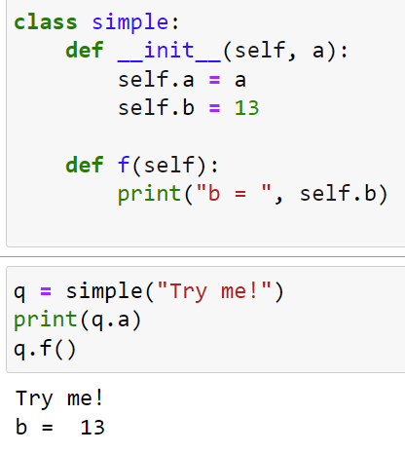
An example: a simple class (simple_class.jpynb)

Slide 39
An example: a simple class
Name of the class
The __init__ function is compulsory. It
is called every time a new object of this
class is created.

Slide 40
An example: a simple class
The parameter self is very special. We use
it to access the attributes
and methods defined within the class .
Note that it must be the first
parameter in every method of the class.

Slide 41
An example: a simple class
The other parameter a is used to pass value to
the object to be created.

Slide 42
An example: a simple class
This class has
two attributes: self.a
and self.b, and
one method: f

Slide 43
An example: a simple class
The statement is to create an instance
of the class simple, and assign a
reference of this instance to the
variable q.
But, exactly what will happen
when this statement is executed?

Slide 44
An example: a simple class
Following are what will happen:
Create an object of simple
objx

Slide 45
An example: a simple class
Following are what will happen:
Create an object of simple
Execute __init__
objx

Slide 46
An example: a simple class
self: objx
a: “Try me!”
Following are what will happen:
Create an object of simple
Execute __init__:
(i) arguments passing:
self <= objx; a <= “Try me!”
objx

Slide 47
An example: a simple class
self: objx
a: “Try me!”
Following are what will happen:
Create an object of simple
Execute __init__:
(i) arguments passing:
self <= objx; a <= “Try me!”
(ii) execute stmt in the body:
objx

Slide 48
An example: a simple class
self: objx
a: “Try me!”
Following are what will happen:
Create an object of simple
Execute __init__:
(i) arguments passing:
self <= objx; a <= “Try me!”
(ii) execute stmt in the body:
self.a (== objx.a) ⬅ a (== “Try me!”)
objx
objx.a = “Try me!”

Slide 49
An example: a simple class
self: objx
a: “Try me!”
Following are what will happen:
Create an object of simple
Execute __init__:
(i) arguments passing:
self <= objx; a <= “Try me!”
(ii) execute stmt in the body:
self.a (== objx.a) ⬅ a (== “Try me!”)
self.b (== objx.b) ⬅ 13
objx
objx.a = “Try me!”
objx.b = 13

Slide 50
An example: a simple class
self: objx
a: “Try me!”
Following are what will happen:
Create an object of simple
Execute __init__:
(i) arguments passing:
self <= objx; a <= “Try me!”
(ii) execute stmt in the body:
self.a (== objx.a) ⬅ a (== “Try me!”)
self.b (== objx.b) ⬅ 13
(iii) return self (== objx) and
assign the returned value to q
objx
objx.a = “Try me!”
objx.b = 13
q
objx

Slide 51
An example: a simple class
self: objx
a: “Try me!”
objx
objx.a = “Try me!”
objx.b = 13
q
objx
print(q.a) == print(objx.a)
== print(“Try me!”)

Slide 52
An example: a simple class
self: objx
a: “Try me!”
objx
objx.a = “Try me!”
objx.b = 13
q
objx
q.f():
(i) argument passing:

Slide 53
An example: a simple class
self: objx
a: “Try me!”
objx
objx.a = “Try me!”
objx.b = 13
q
objx
q.f():
(i) argument passing: ?? where is the first argument??

Slide 54
An example: a simple class
self: objx
a: “Try me!”
objx
objx.a = “Try me!”
objx.b = 13
q
objx
first argument
q.f():
(i) argument passing: ?? where is the first argument??

Slide 55
An example: a simple class
self: objx
a: “Try me!”
objx
objx.a = “Try me!”
objx.b = 13
q
objx
first argument
q.f():
(i) argument passing:
self ⬅ q (== objx)

Slide 56
An example: a simple class
self: objx
a: “Try me!”
objx
objx.a = “Try me!”
objx.b = 13
q
objx
first argument
q.f():
(i) argument passing:
self ⬅ q (== objx)
(ii) execute stmt in body:
print(“b = “, self.b (== objx.b ==13))

Slide 57
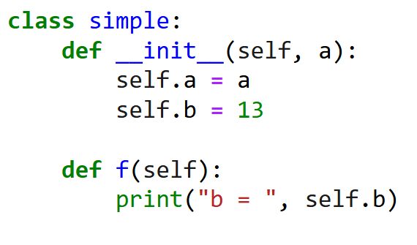
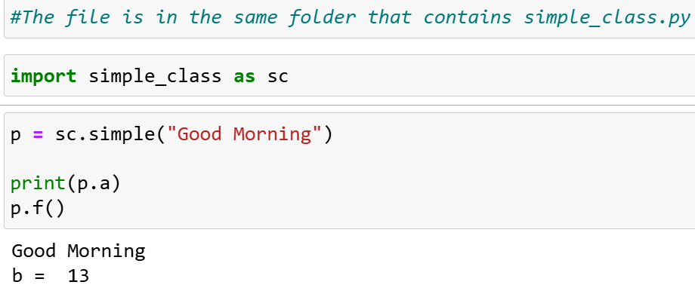
Using a class from another program
_{The file simple_class.py}
_{The file module.jpynb}

Slide 58
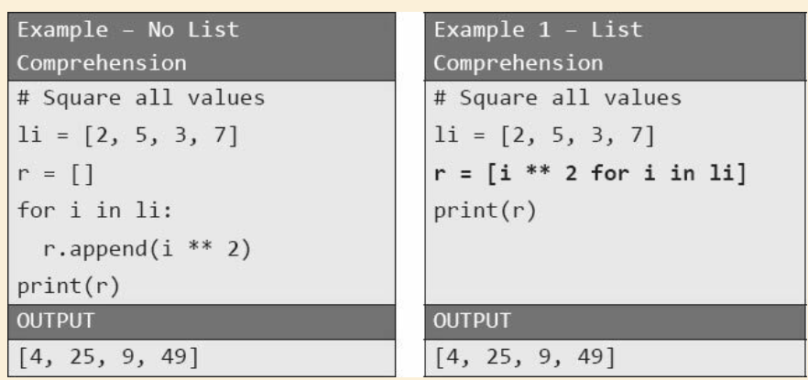
List comprehension
A fast and elegant way to construct a list

Slide 59
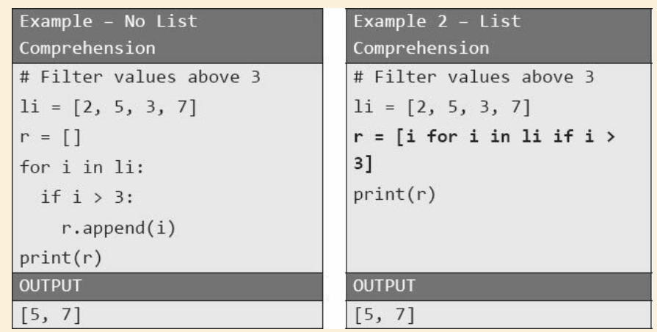
List comprehension
A fast and elegant way to construct a list

Slide 60
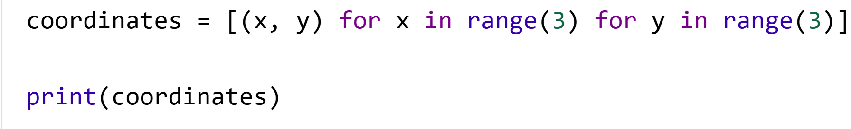
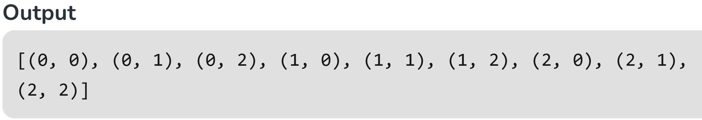
List comprehension
A fast and elegant way to construct a list

Slide 61
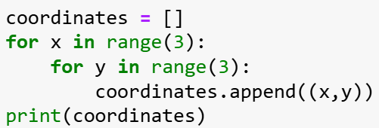
List comprehension
A fast and elegant way to construct a list
≅

Slide 62
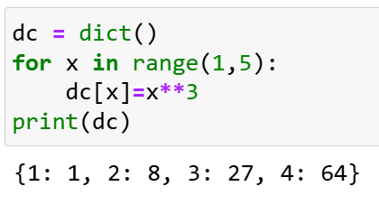
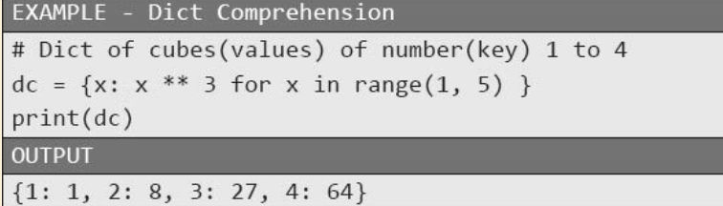
Dictionary comprehension
≅

Slide 63
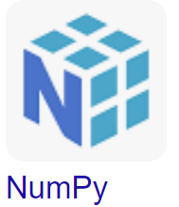
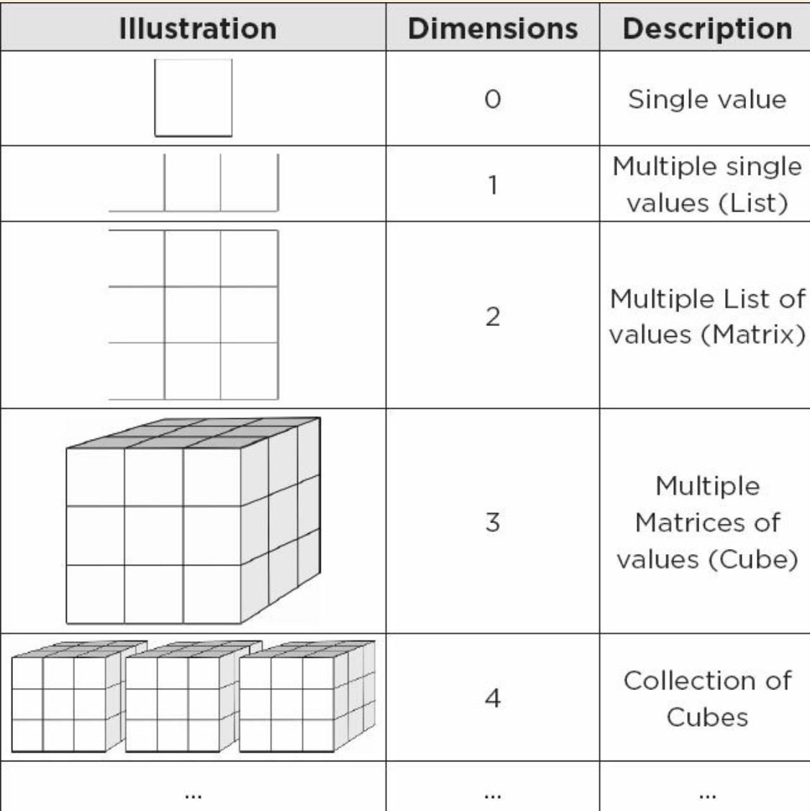
Very brief introduction on NumPy
Major data structures: Ndarray, i.e, Multidimensional array.
A 1-D array is like a list of numbers in Python (but you will see later that the two are very different).
A 2-D array corresponds to a matrix (table).
A 3-D array corresponds to a cube

Slide 64
Very brief introduction on NumPy
Element-wise computation:
NumPy provides a set of functions for performing element-wise computation with arrays and mathematical operations between arrays. (More details about element-wise computation will be given a few slides later.)
Some algorithms can have a considerable performance increase after using numpy.

Slide 65
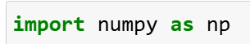
How to import numpy into your program?
Not compulsory, but is very
commonly used “name” for
calling numpy

Slide 66
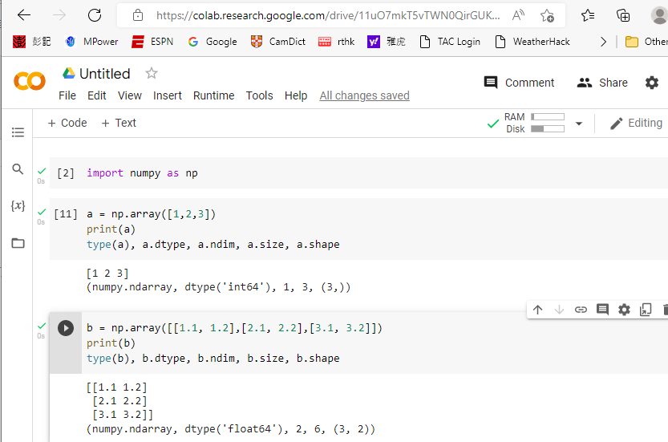
Constructing a numpy array from a Python list
This is a tuple with two elements.

Slide 67
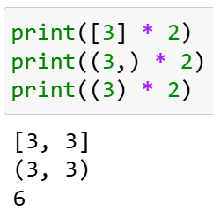
Constructing a numpy array from a Python list
This is a tuple with one element.
Warning: (3, ) and (3) are different:
(3, ) is a tuple with one element
(3) is the integer 3
Example:
Remember the repetitive operator for
list: [1, 2, 3] * 2 == [1, 2, 3, 1, 2, 3]

Slide 68
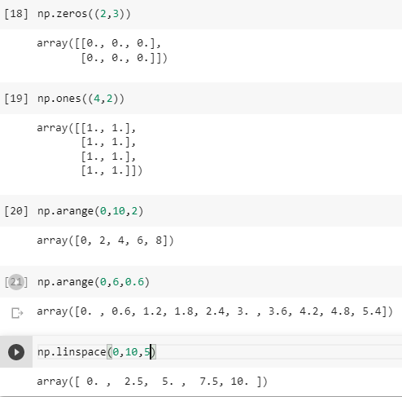
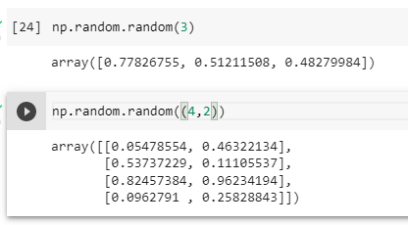
Simple ways to create filled ndarray

Slide 69
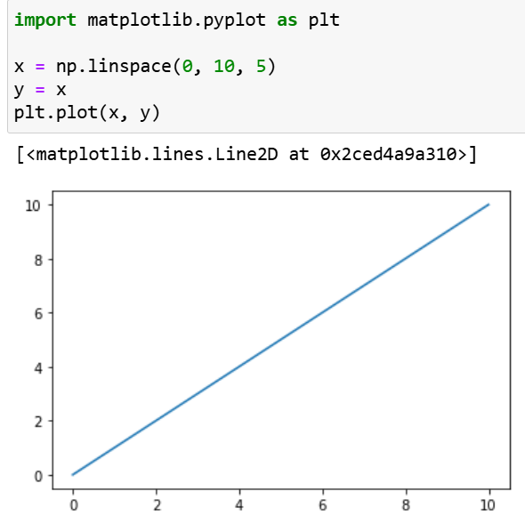
Simple ways to create filled ndarray
very useful for plotting graph

Slide 70
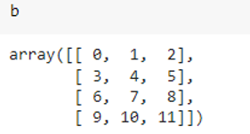
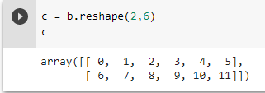
Reshaping an array
Create a empty 2D array c with
shape (2, 6)
and pick the entries from b from left to right, top to bottom,
and put them in c one by one from left to right, top to bottom

Slide 71
Reshaping an array
Create a empty 2D array c with
shape (2, 6)
Note: Recall that shape is a tuple, so
the call reshape(2, 6) should be
reshape((2, 6)). But in Python, we can
eliminate the parathesis enclosing the
tuple, i.e., (2, 6) is the same as 2, 6.
and pick the entries from b from left to right, top to bottom,
and put them in c one by one from left to right, top to bottom

Slide 72
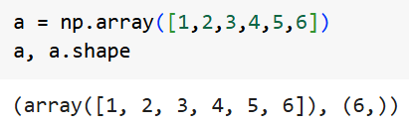
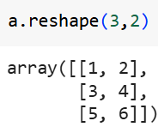
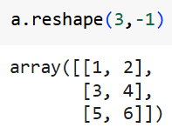
Reshaping an array

Slide 73
Reshaping an array
If we set a dimension to -1, the actual
value of this dimension is computed (inferred)
from the size and the remaining
dimensions.
reshape() will not modify the array,
instead, it returns another array with
the new shape.

Slide 74
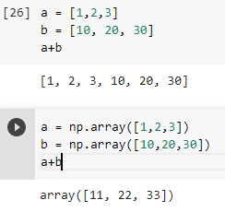
Element-wise operations
An ndarray is very different from the standard Python list:

Slide 75
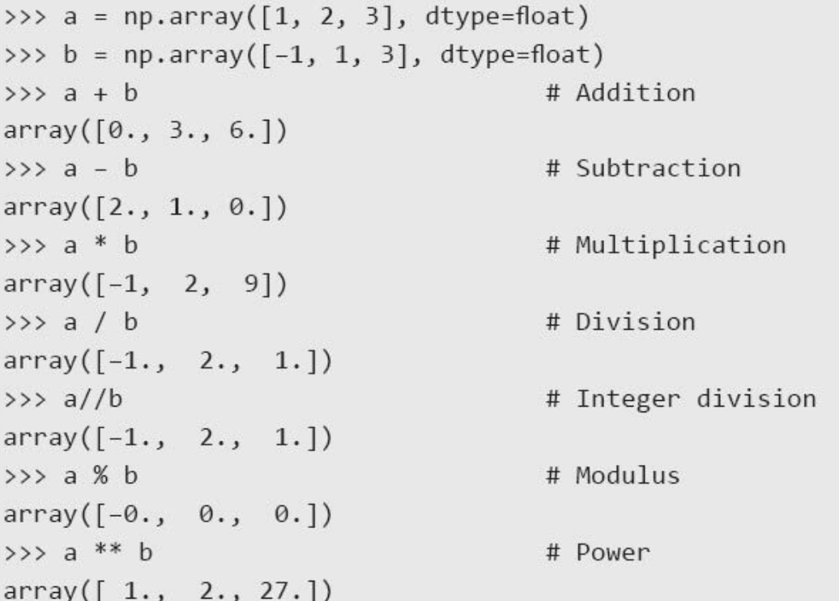
Element-wise operations
Some simple examples:

Slide 76
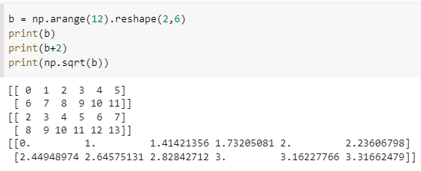
Element-wise on functions
Consider the following example:

Slide 77
Element-wise on functions
Consider the following example:
??? the two operands not
with the same shape???
Because of the “Broadcasting”
capability of numpy.
Broadcasting is a great feature
that allows great flexibility.
Shortly, broadcasting is the ability
to perform an operation between
arrays that do not have the exact
same size or shape!

Slide 78
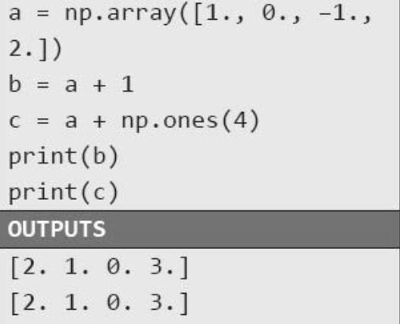
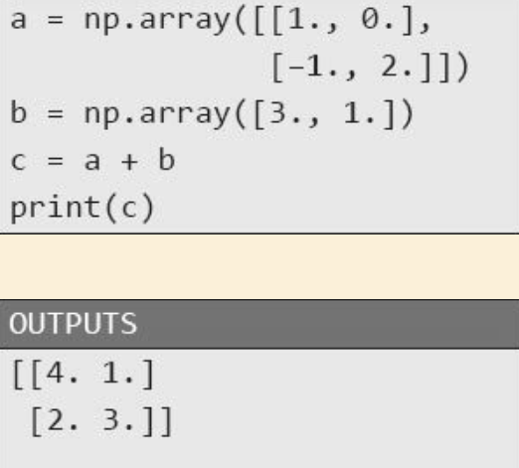
Broadcasting

Slide 79
Broadcasting
The general rules for numpy
array broadcasting are rather
complicated. Later, we will only
broadcast a value, or an 1D array
to some multi-dimensional array

Slide 80
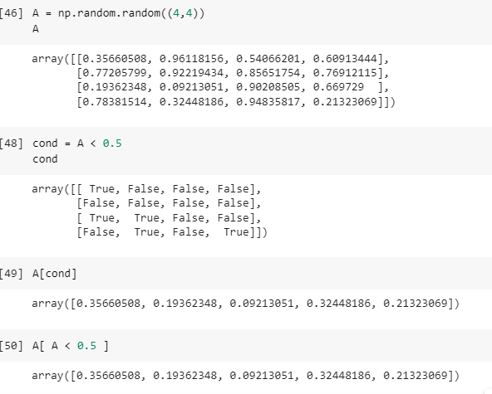
Conditions, Boolean Arrays and Selection

Slide 81
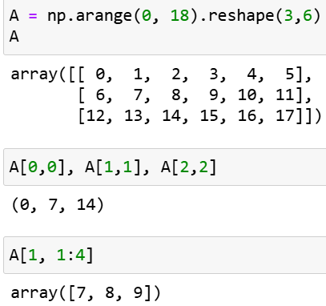
Indexing and slicing an ndarray
Just like a Python list, we can access an ndarray by indexing or by slicing.

Slide 82
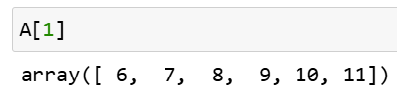
Indexing and slicing an ndarray
Just like a Python list, we can access an ndarray by indexing or by slicing.
row with index 0, 1, 2
column with index
0, 1, 2, 3, 4, 5
the stopping index
is not included in
the “output”.

Slide 83
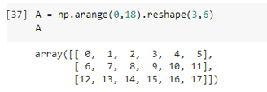

Indexing and slicing an ndarray
Another example:

Slide 84
Indexing and slicing an ndarray
Positive and Negative indices
We can access any specific element in an ndarray by its positive index p and its negative index n
Relationship between n and p: p = n + len(a)
a[3] = a[-6] = 4.4
1.1 | 2.2 | 3.3 | 4.4 | 5.5 | 6.6 | 7.7 | 8.8 | 9.9
0 | 1 | 2 | 3 | 4 | 5 | 6 | 7 | 8
-9 | -8 | -7 | -6 | -5 | -4 | -3 | -2 | -1
a =

Slide 85
Indexing and slicing an ndarray
A slice can be (i) a[start:stop:step] or (ii) a[start:stop].
((ii) is (i) with step having the default value 1.)
As in Python list, the resulting slice is
[start, start+step, …, start + k * step]
where is the largest k such that (start + k * step) < stop
(Note: the slice does not include the stopping index).
1.1 | 2.2 | 3.3 | 4.4 | 5.5 | 6.6 | 7.7 | 8.8 | 9.9
0 | 1 | 2 | 3 | 4 | 5 | 6 | 7 | 8
-9 | -8 | -7 | -6 | -5 | -4 | -3 | -2 | -1
a =

Slide 86
Indexing and slicing an ndarray
Default values for the start and stop index.
When step > 0:
When step < 0:
0 | 1 | 2 | 3 | 4 | 5 | 6 | 7 | 8
default first position
default last position
a[0:9:1] = a[ : : 1]
default last position + 1
-9 | -8 | -7 | -6 | -5 | -4 | -3 | -2 | -1
default last position
default first position
a[-1:-10:-1] = a[ : : -1]
ending index = default last position - 1

Slide 87
Indexing and slicing an ndarray
Basic steps for determining a slice:
determine the value of step
If step > 0
fill in, if missing, the default start and stop index.
convert all negative index to the equivalent positive index
If step < 0
fill in, if missing, the default start and stop index.
convert all positive index to the equivalent negative index
Determine the slice
1.1 | 2.2 | 3.3 | 4.4 | 5.5 | 6.6 | 7.7 | 8.8 | 9.9
0 | 1 | 2 | 3 | 4 | 5 | 6 | 7 | 8
-9 | -8 | -7 | -6 | -5 | -4 | -3 | -2 | -1
a =
Exercises:
a[::-1]
a[1::-1]
a[-3:-1]
a[-2:]
a[:-2]

Slide 88


The Ellipsis

Slide 89

The Ellipsis
The ellipsis automatically expands
the necessary number of ‘:’.

Slide 90

Very brief introduction of Pandas
Pandas: A powerful Python Data Analysis Library
The library was designed and developed primarily by Wes McKinney starting in 2008. In 2012, Sien Chang, one of his colleagues, was added to the development. Together they set up one of the most used libraries in the Python community.
Pandas supports two major data structures:
Series: Extension of Numpy’s 1D-array
Dataframes: A 2D table

Slide 91
Series
Series is the Pandas 1-dimensional structure. It is a useful extension of Numpy array.
Extension of the notion of index: index and index label
index: position of the values: 0, 1, 2, …
index label: give a name to the each index in a Series.
If index labels are not provided in its creation, they follows the usual index sequence, i.e., 0, 1, 2, …

Slide 92


Creating Series: using the pd.Series method
Create a Series from a Python list
index label

Slide 93

Creating Series: using the pd.Series method
Create a series from a Python dictionary

Slide 94
Creating Series: using the pd.Series method
Create a series from a Python dictionary
caution: dict does not have order
you cannot be sure the order of
the series constructed

Slide 95

Obtain the values only (i.e., without row labels)

Slide 96



Access the elements in a Series
We have two ways to access the
elements of a Series:
using the index as if it is a numpy
array; or
(2) using the series’s index labels

Slide 97
Access the elements in a Series
We have two ways to access the
elements of a Series:
using the index as if it is a numpy
array; or
(2) using the series’s index labels
Be very careful
The stopping index is not included in the output
The stopping index label is included in the output

Slide 98

Like Numpy Array, element-wise operations are supported

Slide 99

Conditions and Boolean indexing are also supported

Slide 100

Some useful functions on Series

Slide 101

DataFrame
A DataFrame can be thought of as a table like data structure that each column is expressed as a Series.
It can also be seen as an excel spreadsheet which offers very flexible ways of working with it.
...
Column
names
.
.
.
Row labels

Slide 102

Create a DataFrame using pd.DataFrame

Slide 103

Create a DataFrame using pd.DataFrame
Sometimes, the dictionary contains many
columns that are not useful, and we can
select explicitly useful columns to
create the DataFrame

Slide 104

Create a DataFrame using pd.DataFrame
And of course we can give labels to the indexes.

Slide 105

Create a DataFrame using pd.DataFrame
Assigning index labels and selecting columns at the same time:

Slide 106

Create a DataFrame using pd.DataFrame
In addition to dictionary, there are many other ways to create a dataframe, e.g., list of lists, 2D numpy arrays, …

Slide 107


Create a DataFrame using pd.DataFrame
Creating a dataframe from a list of lists

Slide 108


Some functions for information

Slide 109


Some statistical functions

Slide 110

Some statistical functions

Slide 111



Selecting rows and columns
Selecting columns

Slide 112

Selecting rows and columns
Selecting rows
Use the methods
iloc is for selecting by index, and
loc is for selecting by index label.

Slide 113




Selecting rows and columns

Slide 114

Selecting rows and columns

Slide 115



Selecting rows and columns
Again, be careful when slicing a DataFrame
stopping
index not
included
stopping
index label
included

Slide 116
Reading and writing files
Most of public data are delivered in plain text format, excel format, CSV (comma-separated- value) format, or any other delimiter-separated value format.
Pandas provides many methods for reading these files, e.g., read_csv(), read_excel(), read_table(), read_clipboard();
and methods for writing these files, e.g., to_csv(), to_excel, to_table(), ...

Slide 117

An example

Slide 118

Not a Number
Pandas has
many methods
to deal with
this value

Slide 119

Note: We cannot access local file from Colab directly, we need to upload the file first

Slide 120


